Slide 1
Middle School Math Options
October 23, 2023

Slide 2
Middle School Math Grant

Slide 3
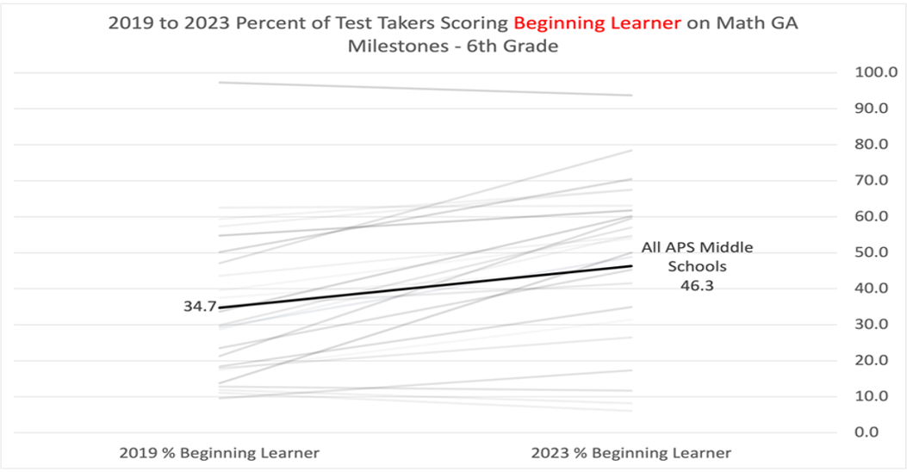
DATA: District

Slide 4
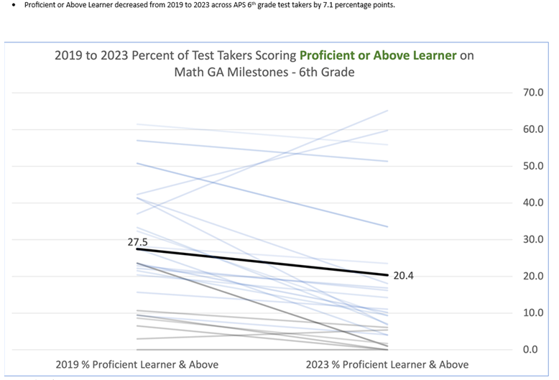
DATA: District

Slide 5
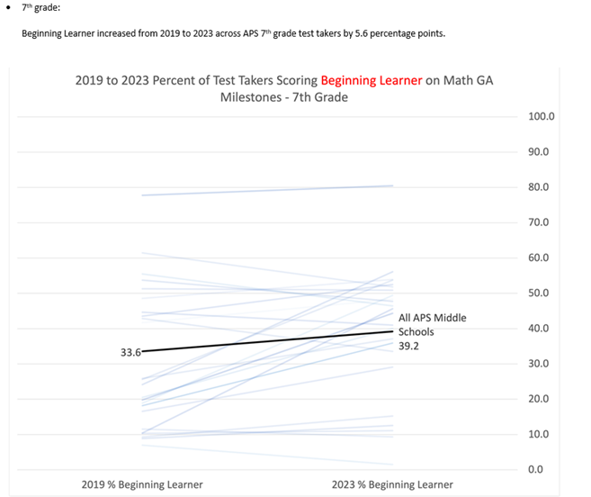
DATA: District

Slide 6
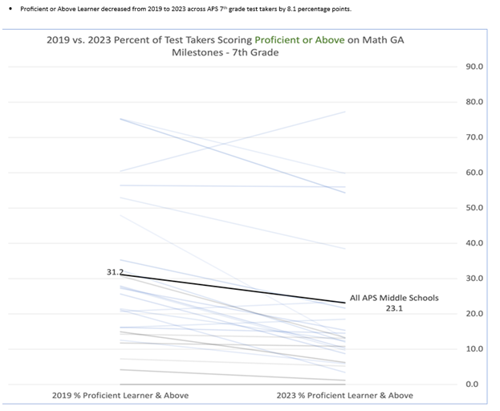
DATA: District

Slide 7
6th grade Beginners levels increased from 2019-2023 and decreased from 2022 to 2023 by 3%
7th grade Beginners levels increased from 2019-2023 and increased from 2022 to 2023 by 5%
8th grade Beginners levels increased from 2019-2023 and increased from 2022 to 2023 by 2%
6th grade Proficient and Distinguished levels decreased by 5% from 2019-2023 but from 22 to 23 increased by 4%
7th grade Proficient and Distinguished levels decreased by 2% from 2019-2023 from 22 to 23 decreased by 4%
8th grade Proficient and Distinguished levels decreased by 4% from 2019-2023 from 22 to 23 increased by 2%
Grade level comparison only

Slide 8
6th graders in 21-22 were 7th graders in 22-23-Current 8th graders
Decreased by 10% of beginners and increased of 3% of Proficient/Distinguished
7th graders in 21-22 were 8th graders in 22-23-Current 9th graders
Increased by 10% of beginners and decreased of 1% of Proficient/Distinguished

Slide 9
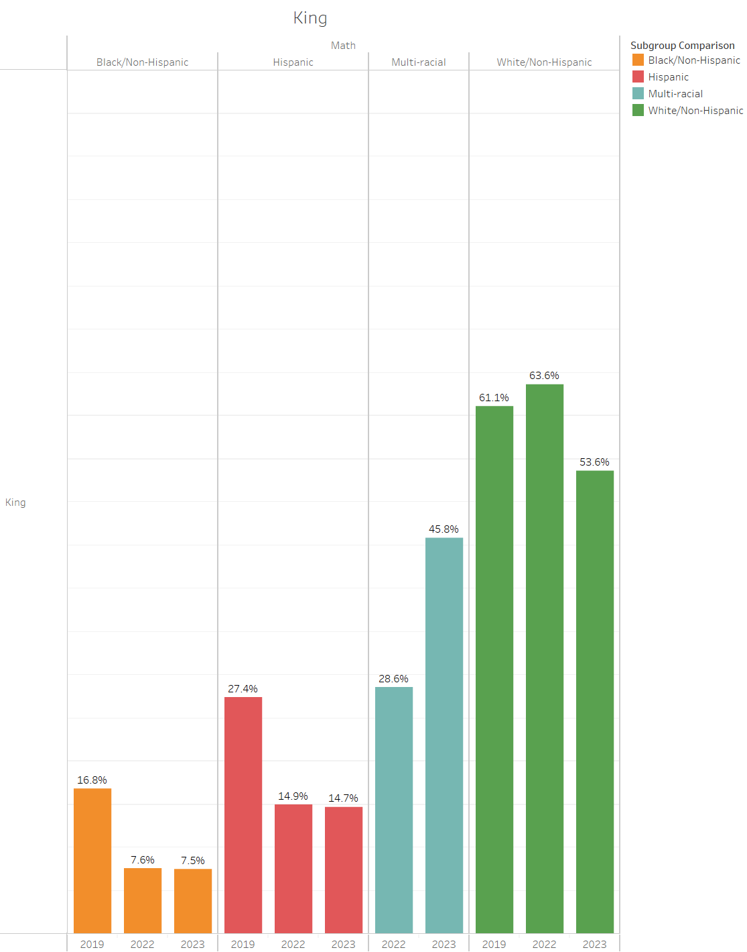
Subgroup Data 2019-2023
All subgroups decreased in proficiency except multi-racial from 2019-2023

Slide 10
Subgroup Data (Students with Disabilities)
2019-2023
Students with disabilities had an increase in proficiency from 2019-2023 from 2.4% proficient and above to 4.1% proficient and above.

Slide 11
So What?
Now What?

Slide 12
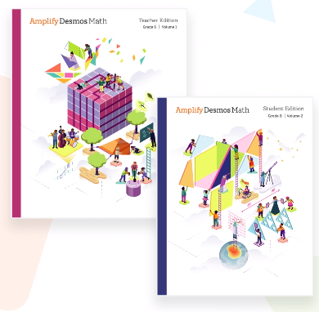
Option One: 6-8 Georgia Standards:
Resource-Amplify
Pros:
Teachers have been implementing for two years
Resources are in schools
Assessments included
Professional development has been offered
District support for GaDOE resources to close gap of new standards
Cons:
Teaching program, not standards
Not directly aligned to new Georgia Math Standards
Too much time in digital platform without students working out problems on paper
Limited differentiation

Slide 13
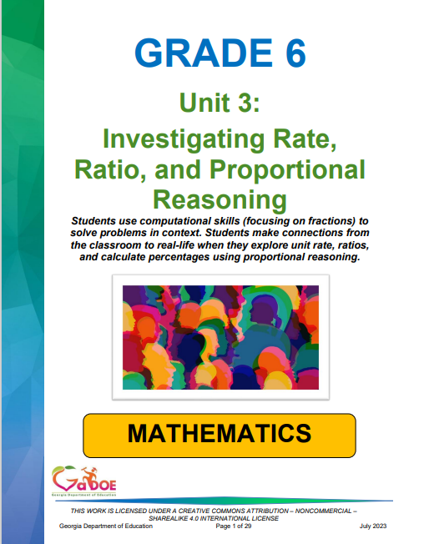
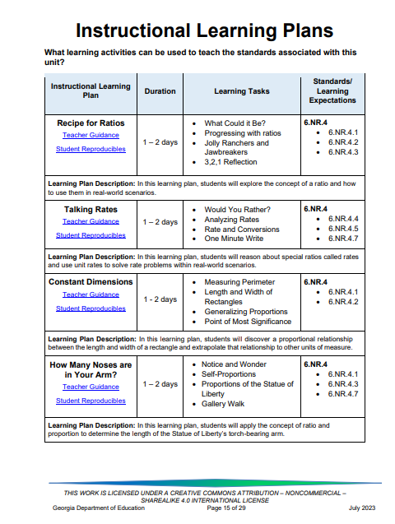
Option Two: 6-8 Georgia Math Standards
Resource-GaDOE Units and Lessons
Pros:
All inclusive units including daily lesson plans
Resources are online, in Inspire
Teacher guidance and student work pages
Professional development modules online
State developed and shared with assessment department that writes milestones
Directly aligned to new standards
Diagnostic assessments included
Differentiation lessons built in the units
Cons:
Teachers will need time to internalize lessons
Unit assessments not included
Will need to print student documents

Slide 14
Option Three: 6-8 Georgia Math Standards
Resource- Amplify/GaDOE Units based on fit for Standard
Pros:
Teachers make informed decisions on lessons based on standards from either resource
Current district guidance documents have some integration of both resources
Different assessments are available in each resource
Familiarity of both resources
Cons:
Time to internalize both resources to make informed instructional decisions
Professional learning on two resources

